Slide 1
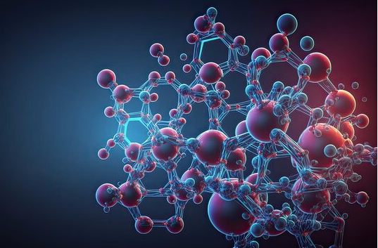

BIOMOLECULE

Slide 2
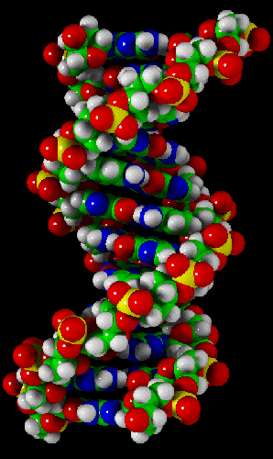
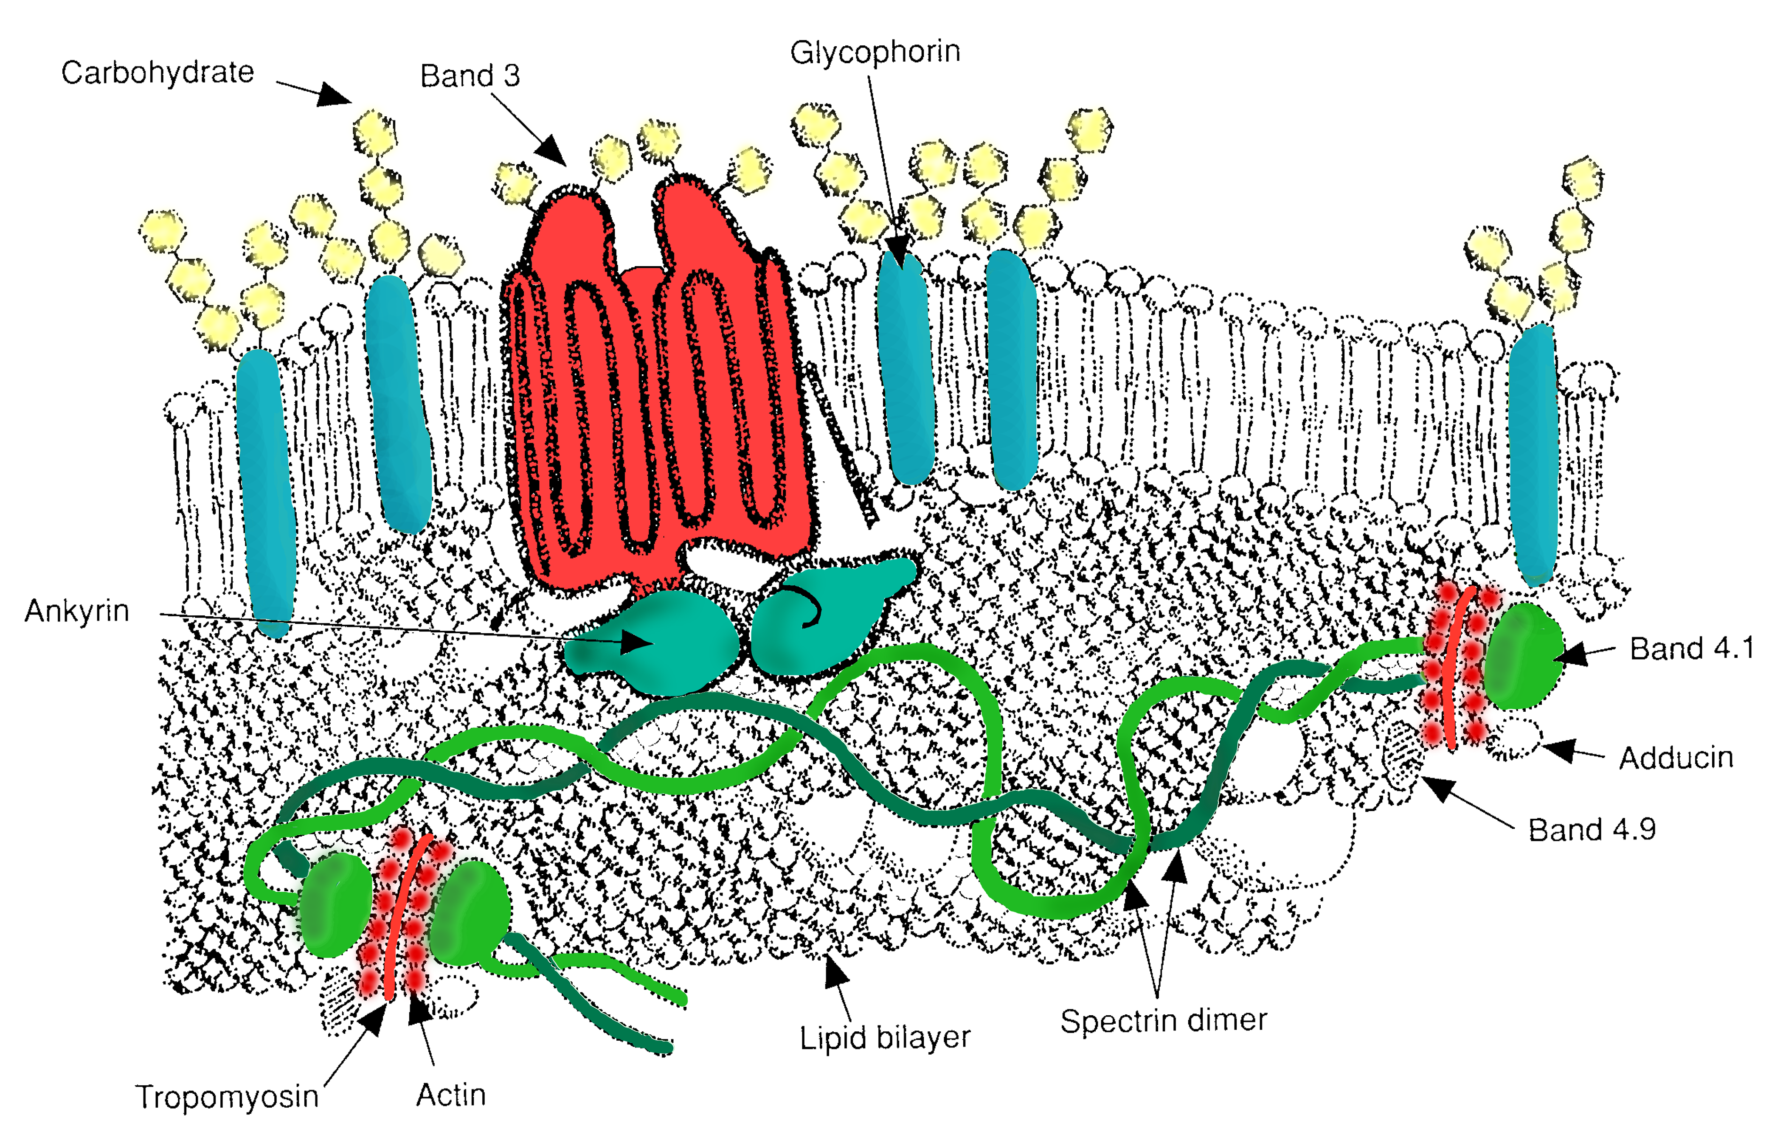
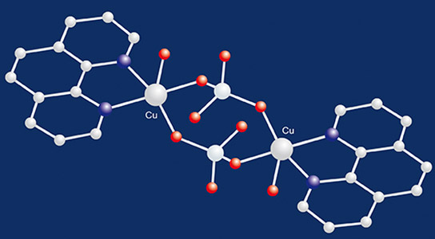
BIOMOLECULE

Slide 3
TOPICS TO BE COVERED
Introduction
Analysis of chemical composition in tissues
Analysis of inorganic compounds
Comparison of elements in living and non-living matter
Biomicromolecules- amino acid, Lipid, Sugars and Nitrogenous base
Biomacromolecules- Proteins, Polysaccharides and Nucleic acid
Secondary metabolites
Enzymes- Activity, Factors affecting activity and types of enzyme
Cofactors

Slide 4
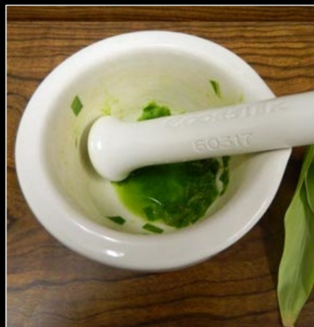
ANALYSIS OF CHEMICAL COMPOSITION IN A TISSUE

Slide 5
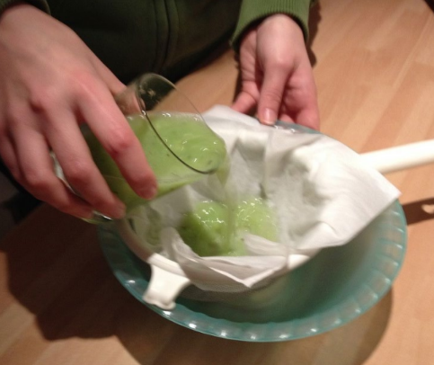

Slide 6
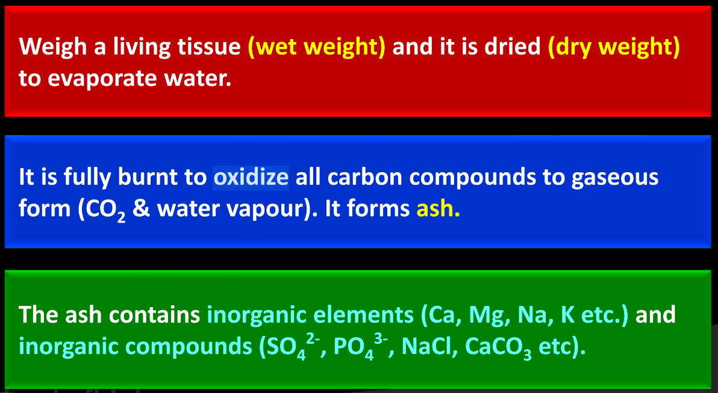
ANALYSIS OF INORGANIC COMPOUNDS

Slide 7
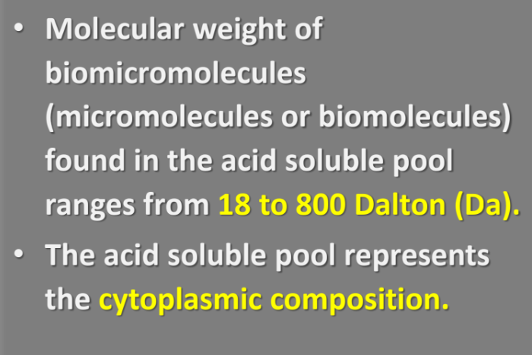
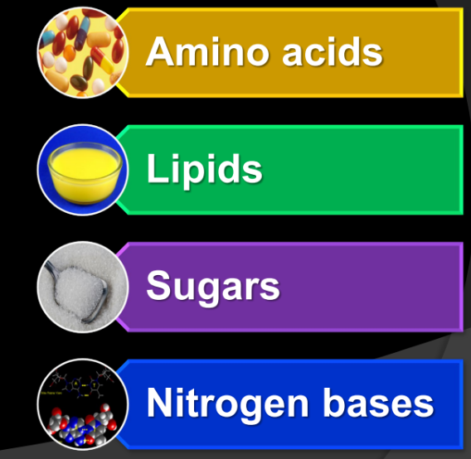
BIOMICROMOLECULES

Slide 8
1. ANMINO ACIDS

Slide 9
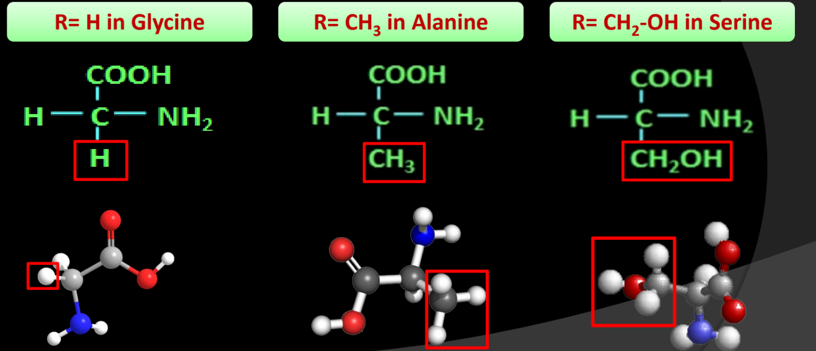

Slide 10
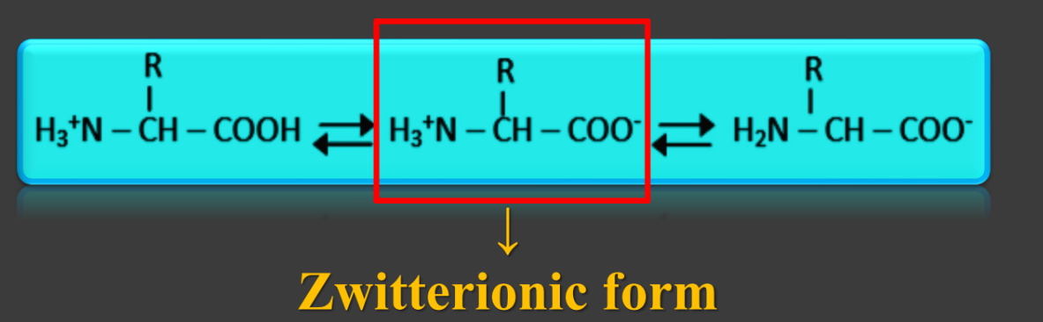
ZWITTERIONIC FORM

Slide 11
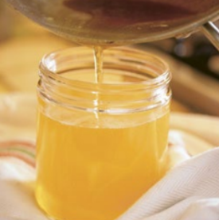
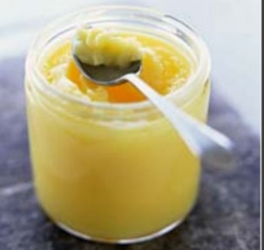
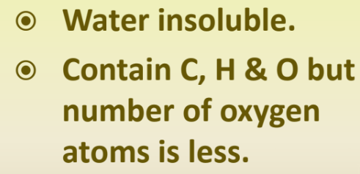
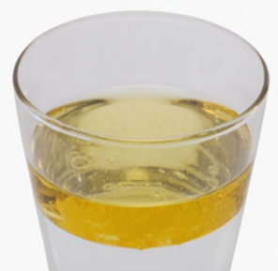
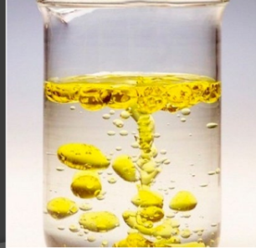
2. LIPIDS

Slide 12
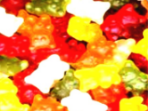
SIMPLE LIPIDS

Slide 13
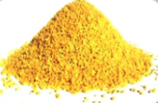
COMPOUND LIPIDS

Slide 14
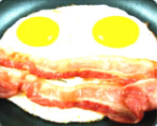
DERIVED LIPIDS

Slide 15
SUGARS (CARBOHYDRATES)

Slide 16
NITROGEN BASES

Slide 17
Choose the element which is negligible in living matter
1. Si 2. Mg 3. Ca 4. S
2. What will be correct sequence of % weight of elements in human body?
1. Na>K>O>C 2. C>H>O>N 3. H>N>Na>S 4. O>C>N>S
3. Identify, in which of the following carbon compounds, heterocyclic rings can be found?
1. Proteins 2. Amino acids 3. Nitrogen bases 4. Lipids

Slide 18
4. Amino acids are substituted methane's. What are the four substituent groups occupying the four valency positions?
1. Hydrogen, carboxyl group, amino group and a variable group (R)
2. Two carboxyl groups, amino group and OH
3. Two hydrogen, one carboxyl group, amino group
4. Two amino groups, one hydrogen and one carboxyl group
5. Identify the correct pair
Proteins Functions
1. Collagen Hormone
2. Antibody Fights infectious agents
3. Insulin Intercellular ground substance
4. Trypsin Enables glucose transport in cell

Slide 19
6. Chemical compounds that have molecular weights less than one thousand Dalton are usually referred to as
1. Biomolecules 2. Micromolecules
3. Macromolecules 4. Both (1) and (2)
7. Which of the following is having low molecular weight but found in acid insoluble fraction?
1. Proteins 2. Carbohydrates
3. Nucleic acids 4. Lipids
8. The least abundant chemical component in living organisms is
1. lipids 2. ions
3. Nucleic acids 4. protein

Slide 20
9. Which of the following is helpful in transport of glucose?
1. Myosin 2. Collagen 3. Keratin 4. GLUT4
Which of the following is 2% of the total cellular mass?
  1. Carbohydrate 2. Lipids
3. Nucleic acid 4. Amino acid
11. Chemical compounds which are found in the acid insoluble fraction are called
1. Biomolecules 2. Macromolecules
3. Macromolecules 4. Both (1) and (2)

Slide 21
12. Identify the amino acids given below and select the correct option
(i) (ii) (iii)
 | (i) | (ii) | (iii)
(1) | Glycine | Serine | Alanine
(2) | Alanine | Glycine | Serine
(3) | Alanine | Serine | Glycine
(4) | Serine | Alanine | Glycine
The 20 different amino acids have different
1. R-groups 2. Carboxylic 3. peptide bonds 4. amino groups

Slide 22
13. Acidic amino acids have two – COOH groups and one NH₂ group per molecule. Select the pair that consists of acidic amino acids.
1. Aspartic acid, glutamic acid
2. Lysine, arginine
3. Glycine, alanine
4. Both (1) and (2)

Slide 23
14. Which of the following is the correct match?
 | Acidic amino acid | Basic amino acid | Neutral amino acid
(1) | Glutamic acid | Lysine | Valine
(2) | Lysine | Valine | Glutamic acid
(3) | Glutamic acid | Valine | Lysine
(4) | Lysine | Glutamic acid | Valine

Slide 24
15. Statement – I : The heterocyclic compounds in nucleic acids are the nitrogenous bases named adenine, guanine, uracil, cytosine and thymine.
Statement – II : Adenine and guanine are substituted pyrimidines while the rest are substituted purines.
16. Statement – I : In a protein, amino acids are linked by a peptide bond which is formed when the carboxyl (-COOH) group of one amino acid react with the amino (-NH₂) group of the next amino acid.
Statement – II : In a polysaccharide the individual monosaccharides are linked by a glycosidic bond.

Slide 25
17. Statement – I : Lysine is a basic amino acid while valine is neutral amino acid.
Statement – II : Tyrosine, phenylalanine and tryptophan are aromatic amino acids.
18. Statement – I : Two hydrogen bonds are present between A and T while three hydrogen bonds are present between G and C
Statement – II : In B-DNA rise per base pair would be 34
Å
19. Statement – I : Palmitic acid has 16 carbons excluding carboxyl carbon.
Statement – II : Arachidonic acid has 20 carbon atoms including carboxyl carbon.

Slide 26
20. Which of the following are not secondary metabolites in plants?
1. Amino acids, glucose 2. Vinblastine, curcumin
3. Rubber, gums 4. Morphine, codeine
21. Identify the basic amino acid from the following
1. Glutamic Acid 2. Lysine
3. Valine 4. Tyrosine
22. A typical fat molecule is made up of
1. One glycerol and one fatty acid molecule
2. Three glycerol and three fatty acid molecules
3. Three glycerol molecules and one fatty acid molecule
4. One glycerol and three fatty acid molecules.

Slide 27
Read the following statements on lipids and find out correct set of statements
a. Lecithin found in the plasma membrane is a glycolipid
b. Saturated fatty acids possess one or more c = c bonds
c. Gingely oil has lower melting point, hence remains as oil in winter
d. Lipids are generally insoluble in water but soluble in some organic solvents
e. When fatty acid is esterified with glycerol, monoglycerides are formed.

Slide 28
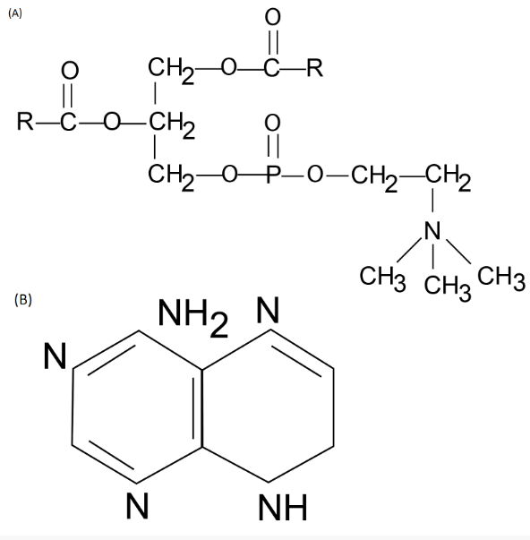
24. Which one of the following structural formulae of two organic compounds is correctly identified along with its related function?
1. A : Lecithin – a component of cell membrane
2. B : Adenine – a nucleotide that makes up nucleic acids
3. A : Triglyceride – major source of energy
4. B : Uracil – a component of DNA

Slide 29
25. Read the following statements (A-F):
A – Lecithin is found in cell wall
B – Collagen is most abundant protein on earth
C – Chitin is found in cell wall of fungi
D – Fats have higher melting point than oils
E – Zwitter ionic form can be observed in amino acids
F – Protein is a homopolymer
How many of the above statements are true?
1. 0 2. 1 3. 3 4. 2

Slide 30
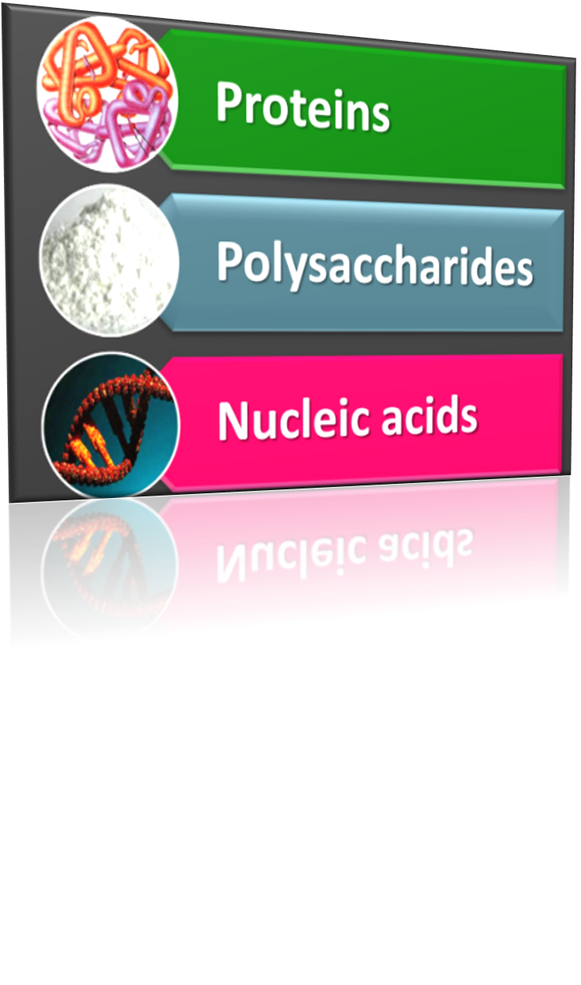
BIOMACROMOLECULES
These are biomolecules having molecular weight greater than 1000 Da
They include

Slide 31
1. PROTEINS

Slide 32
2. POLYSACCHARIDES

Slide 33
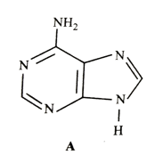
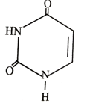



26. Identify the given structural formulae and select the correct option
Adenine Uracil
Guanine Thymine
Adenine Guanine
Cytosine Thymine

Slide 34
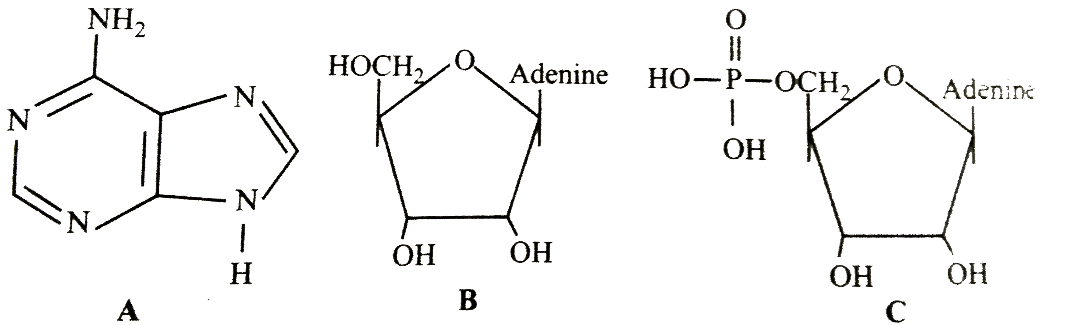
27. The three structural formulae A, B and C are given here. Identify them and select the correct option.

Slide 35
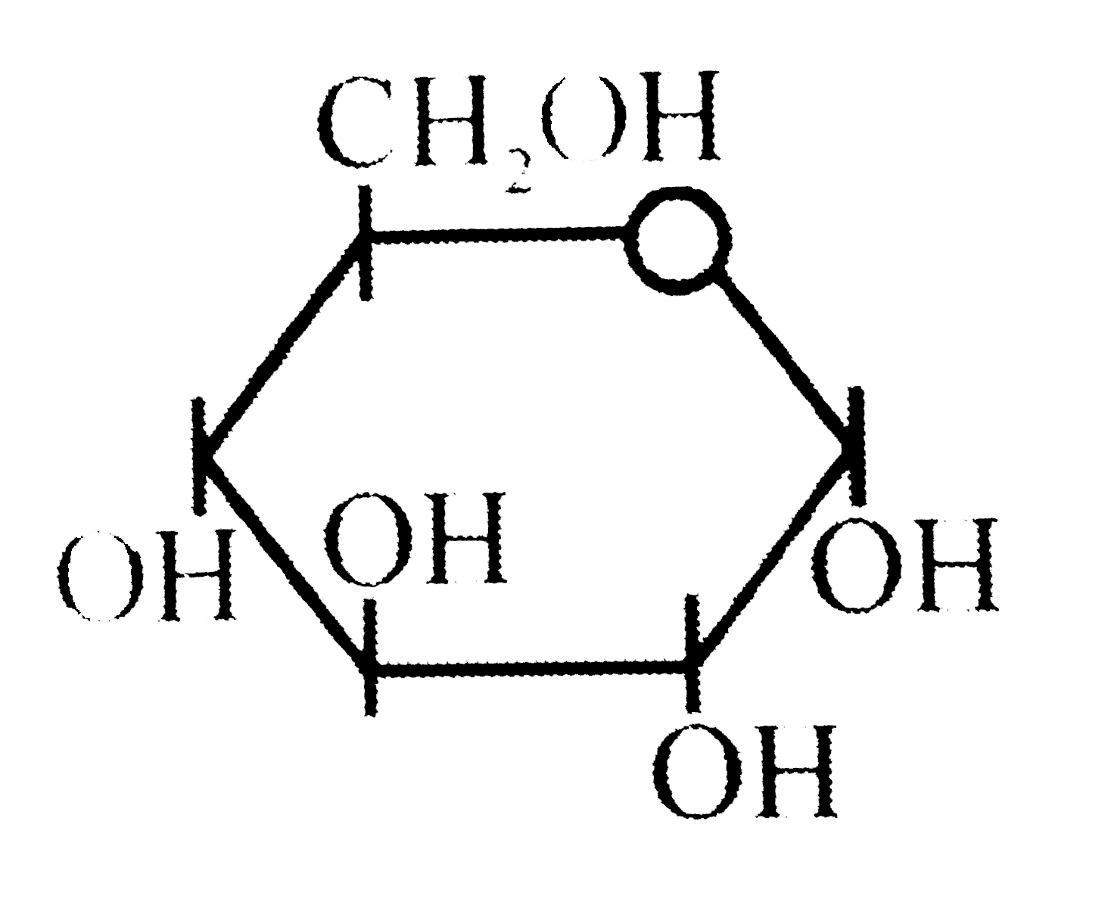
28. The below structural formula belongs to
1. Glucose 2. Ribose 3. Sucrose 4. Deoxyribose

Slide 36
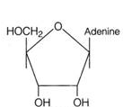
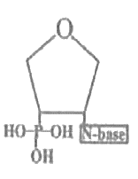
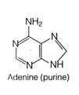
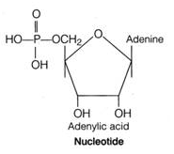
29. Which one of the following is the diagrammatic representation of a nucleotide?

Slide 37
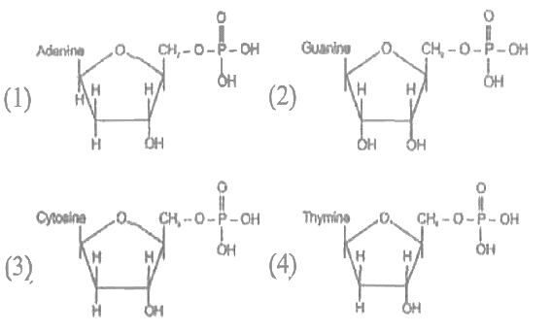
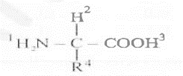
30. All of the following nucleotides are present in DNA, except
31. Which of the two groups of following formula involved in peptide bond between different amino acids?
1. 2 and 3 2. 1 and 3 3. 1 and 4 4. 2 and 4

Slide 38
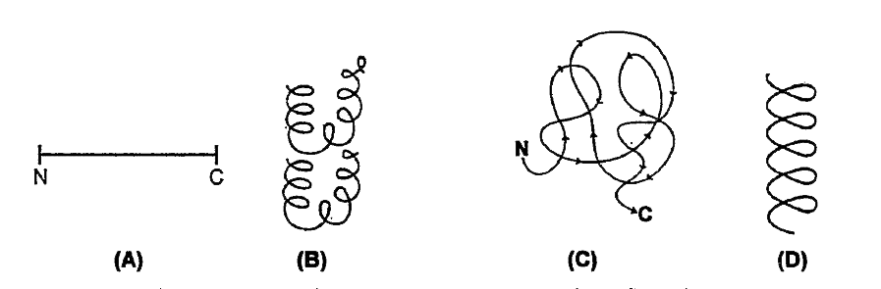
32. What kinds of the structures of proteins are shown in the below figure
1. A = 1° structure, B = 2° structure, C = 3° structure, D = 4° structure
2. A = 4° structure, B = 2° structure, C = 3° structure, D = 1° structure
3. A = 1° structure, B = 4° structure, C = 3° structure, D = 2° structure
4. A = 4° structure, B = 3° structure, C = 2° structure, D = 1° structure

Slide 39
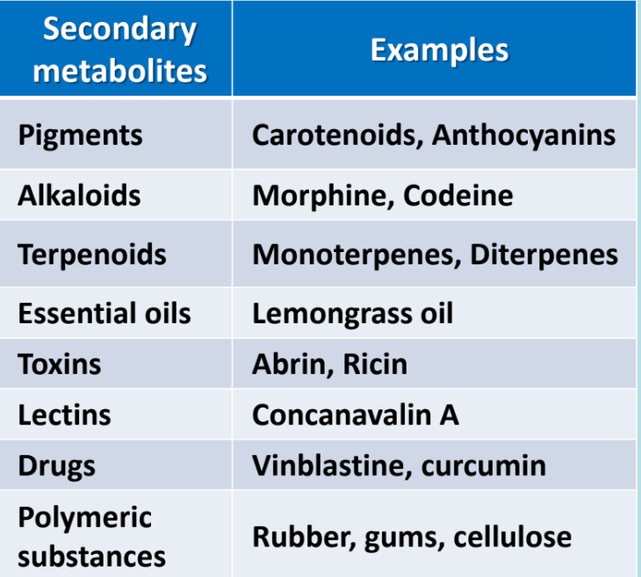
SECONDARY METABOLITES

Slide 40
33. Match column I with column II and select the correct option from the given codes.
Column I (Category) | Column II (Secondary metabolites)
Pigments | i) Concanavalin A
B. Terpenoides | ii) Monoterpenes, diterpenes
C. Alkaloids | iii) Morphine, codeine
D. Lectins | iv) Carotenoids, anthocyanins
1. A – (iv), B – (ii), C – (iii), D – (i) 2. A – (iv), B – (iii), C –(ii), D – (i)
3. A – (i), B – (iv), C – (iii), D – (ii) 4. A – (i), B – (iii), C –(ii), D – (iv)

Slide 41
34. Which of the following secondary metabolites are used as drugs?
1. Abrin and ricin 2. Vinblastin and curcumin
3. Anthocyanins 4. Gums and cellulose
35. Identify the incorrect pair
1. Toxin - Abrin
2. Lectins - Concanavalin A
3. Drugs - Ricin
4. Alkaloids - Codeine

Slide 42
36. Match column I with column II and select the correct option from the codes given below
A. Morphine - I. Toxin
B. GLUTN - II. Drug
C. Curcumin - III. Alkaloid
D. Ricin - IV. Sensory receptor
V. Glucose transport (Protein)
1. A – (iiii), B – (v), C – (ii), D – (iv) 2. A – (iii), B – (v), C –(ii), D – (i)
3. A – (ii), B – (iii), C – (i), D – (iv) 4. A – (iii), B – (i), C –(ii), D – (iv)

Slide 43
37. Which set of secondary metabolites belong to category alkaloids?
1. Rubber, Gums 2. Morphine, Codeine
3. Anthocyanins, Carotenoids 4. Abrin, Ricin
38. Abrin and ricin are
1. Toxins 2. Drugs
3. Essential oils 4. Alkaloids
Lemon grass oil belong to which category of secondary metabolites?
1. Alkaloids 2. Lectins
3. Essential oils 4. Toxins

Slide 44
40. Which of the following secondary metabolite is lectin?
1. Concanavalin A 2. Curcumin
3. Anthocyanins 4. Abrin
41. All of the following are polymeric secondary metabolites except
1. Cellulose 2. Gums
3. Codeine 4. Rubber
42. Identify a secondary metabolite
1. Vinblastine 2. Nucleotide
3. Amino acids 4. Lipids

Slide 45
43. Among the following metabolites, how many are secondary metabolites?
[Lipids, Diterpenes, Abrin, Curcumin, Amino acids, Gums, Cellulose, Concanavalin A, Carotenoids, Nucleotides, Protein, Morphine, Carbohydrates]
1. 4 2. 5 3. 6 4. 8

Slide 46
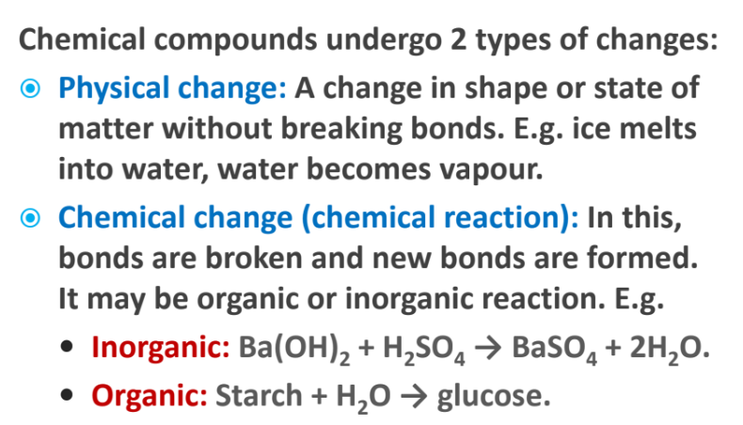
ENZYMES
CHEMICAL REACTIONS

Slide 47
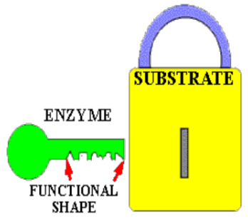
NATURE OF ENZYME ACTION (CATALYTIC CYCLE)

Slide 48
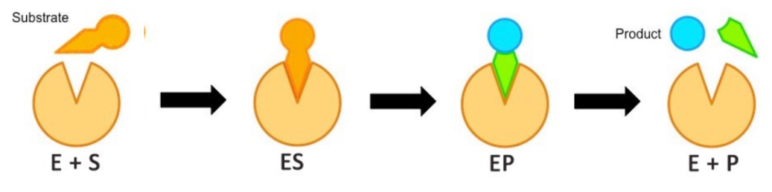

Slide 49
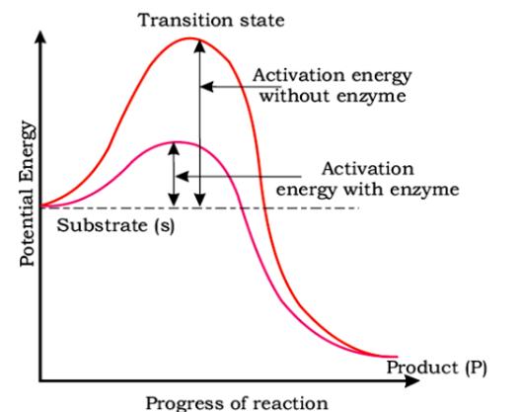
CONCEPT OF ACTIVATION ENERGY

Slide 50

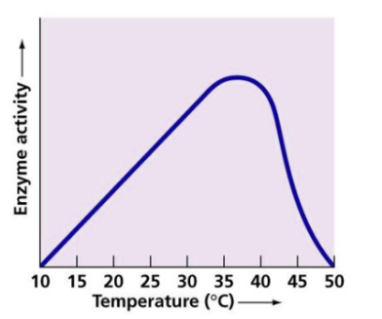
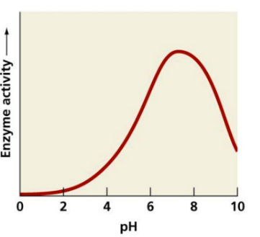
FACTORS AFFECTING ENZYME ACTIVITY

Slide 51
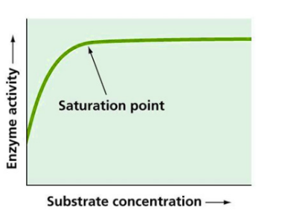
CONCENTRATION OF THE SUBSTRATE

Slide 52
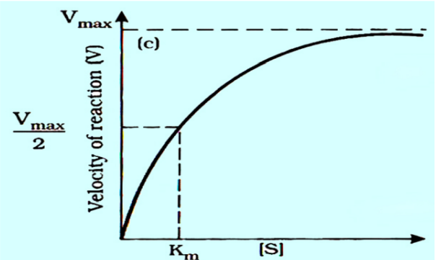

Slide 53
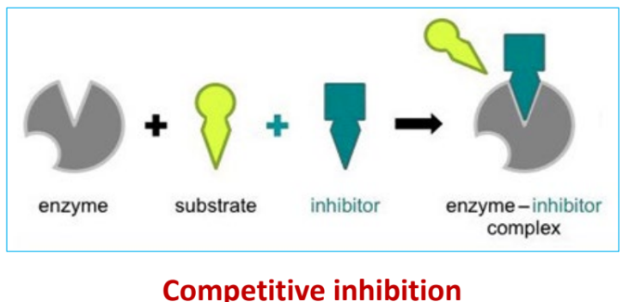
PRESENCE OF INHIBITOR

Slide 54
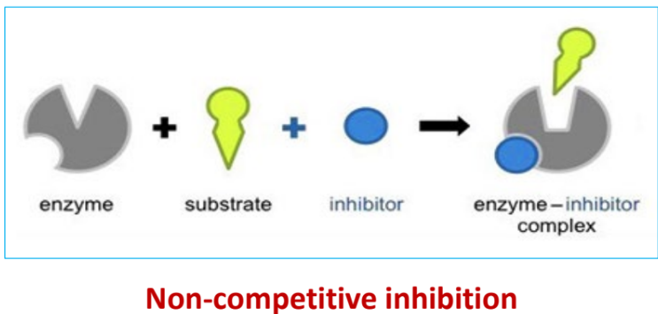

Slide 55
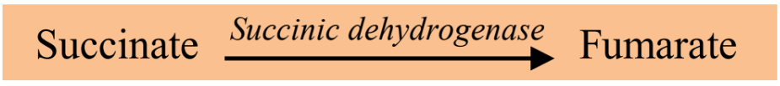

Slide 56
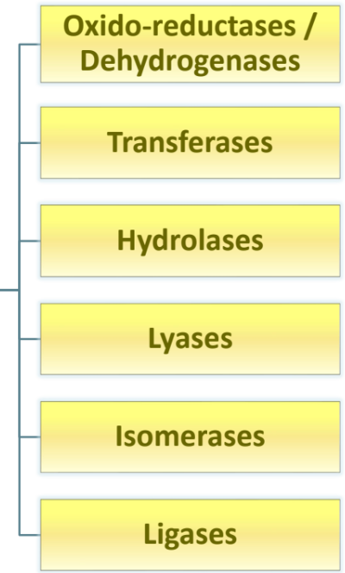
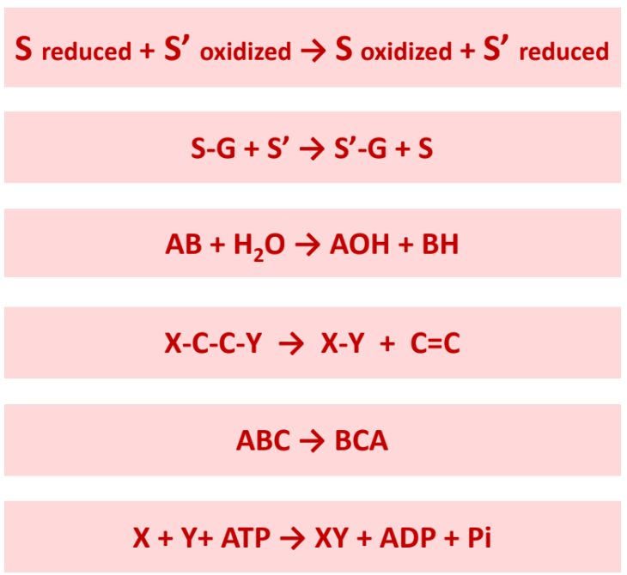
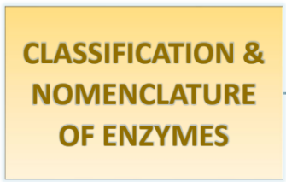
CLASSIFICATION & NOMENCLATURE OF ENZYMES

Slide 57

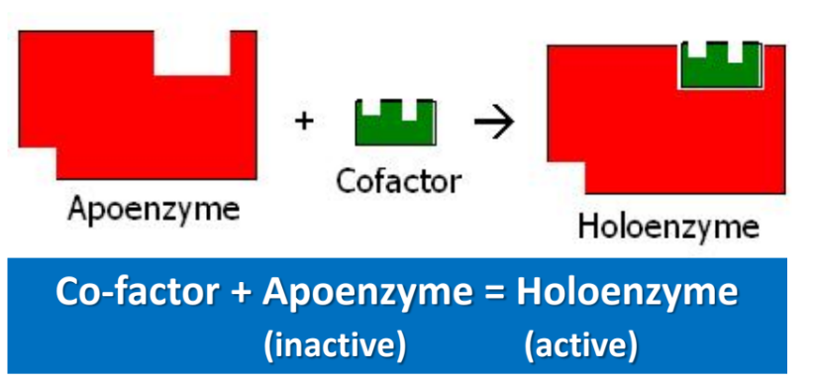

Slide 58



Slide 59


Slide 60


Slide 61
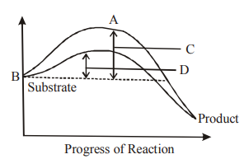
44. The figure given shows the conversion of substrate into product by an enzyme, In which one of the four options. (A-D) the components of the reaction labelled A,B,C,D are identified correctly:
 | A | B | C | D
i) | Potential energy | Transition state | Activation energy with enzyme | Activation energy without enzyme
ii) | Transition state | Potential energy | Activation energy with enzyme | Activation energy without enzyme
iii) | Potential energy | Transition state | Activation energy with enzyme | Activation energy with enzyme
iv) | Activation energy with enzyme | Transition state | Activation energy with enzyme | Potential energy

Slide 62
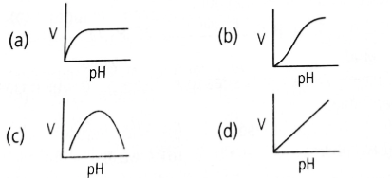
45. Which one of the given shows the effect of pH on velocity of a typical enzymatic reaction (V)?

